Slide 1
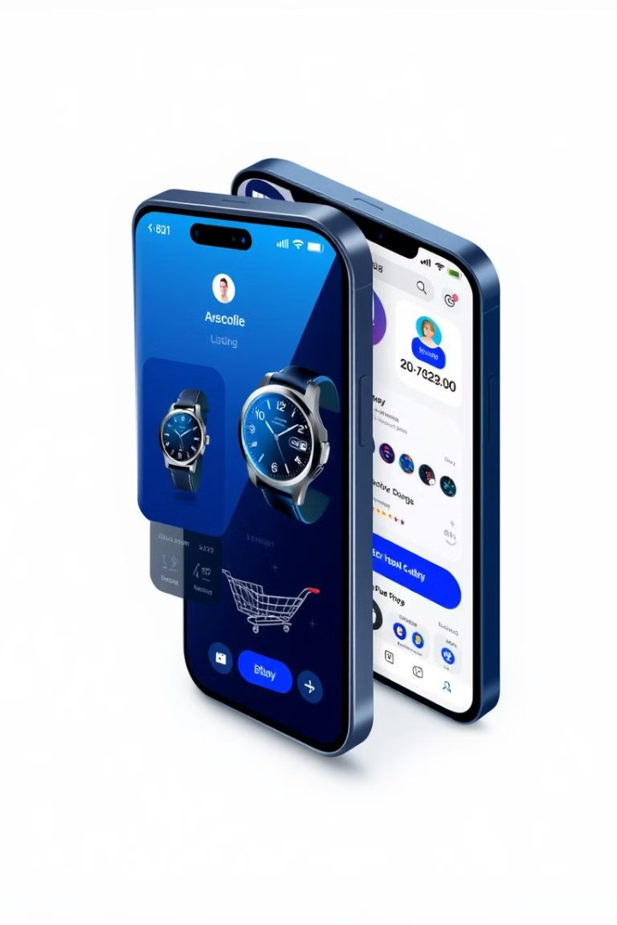
E-Market Place
Name :- Patni Chirag N.
Enroll No. :- 23002170110141
Branch :- CE Roll:- 46

Slide 2
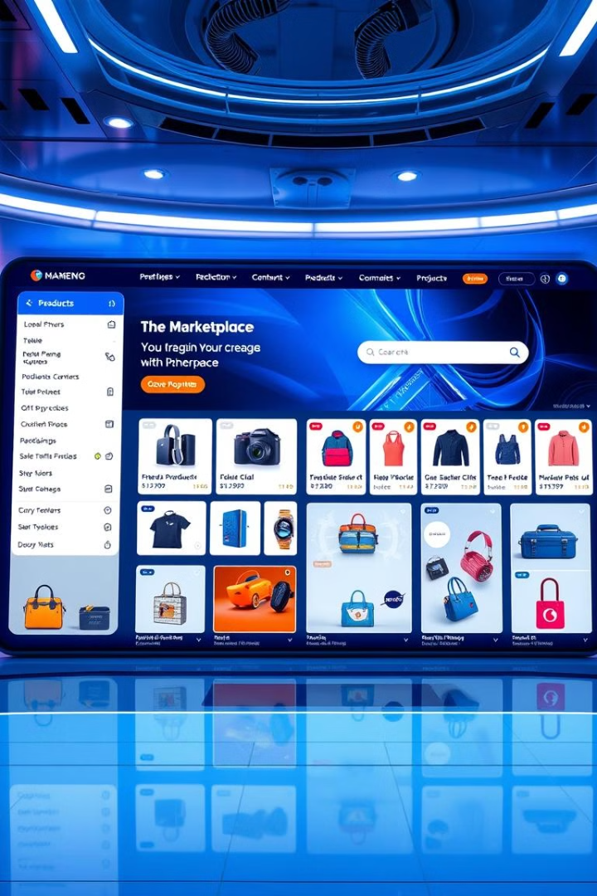
Introduction
What is it?
Key Features
This Python-based application facilitates online shopping, allowing users to browse, add to cart, and purchase items from an e-marketplace.
The application incorporates essential features such as user authentication, product browsing with filtering, a shopping cart, and a comprehensive billing system.

Slide 3
Database Schema
signin
products
pending_cart
User details including user_id, name, email, password, and phone number.
Product details including product_id, name, brand, color, size, rating, and price.
Cart details including pending_cart_id,user_id, product_id and quantity.

Slide 4
ER-Diagram
name
Product_id
User_id(FK)
Product_id
(FK)
email
User_id
P_name
rating
Pandingcart
Signin
1
M
Products
Phone
number
Price
size
Password
quantity
P_cart_id
brand
color

Slide 5
Application Workflow
The application workflow begins with a welcome screen prompting users to sign up or log in.
1
2
Sign up involves entering user details, storing them in the database, and redirecting the user to the login screen.
Login requires validation of user credentials, followed by redirection to the main menu.
3
4
The main menu offers options for shopping, viewing the cart, and exiting the application.
Shopping allows browsing products, adding them to the cart, or proceeding directly to purchase.
5
6
Viewing the cart enables users to remove items or complete the purchase process.
The purchase process culminates in bill generation and transaction completion.
7

Slide 6
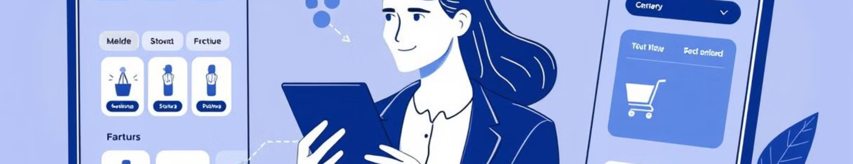
Core Functionality
1
Sign up and log in using your Gmail account, ensuring secure authentication.
2
Browse products by category and filter by price, color, brand, and rating for a personalized shopping experience.
3
Manage your shopping cart by adding or removing items, and view cart details and total price before checkout.
4
Complete your purchase and generate bills for individual or consolidated cart purchases using various payment methods.

Slide 7

Future Enhancements
Add Admin to update the product table , like price , rating ,add product or remove product.
Integrate with reputable payment gateways for real transactions, enabling secure and reliable payment processing.
Recommendation providing to enhance user experience.

Slide 8
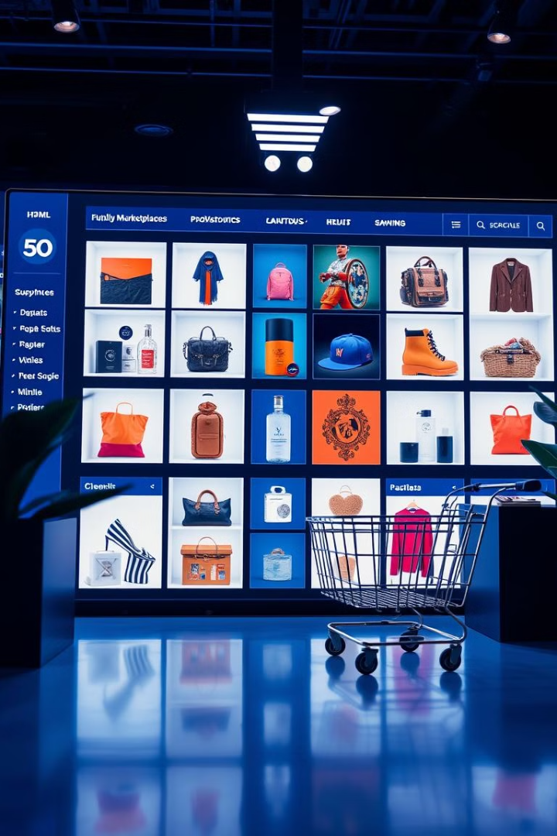
Thank You
We appreciate your time and attention.

